Slide 1
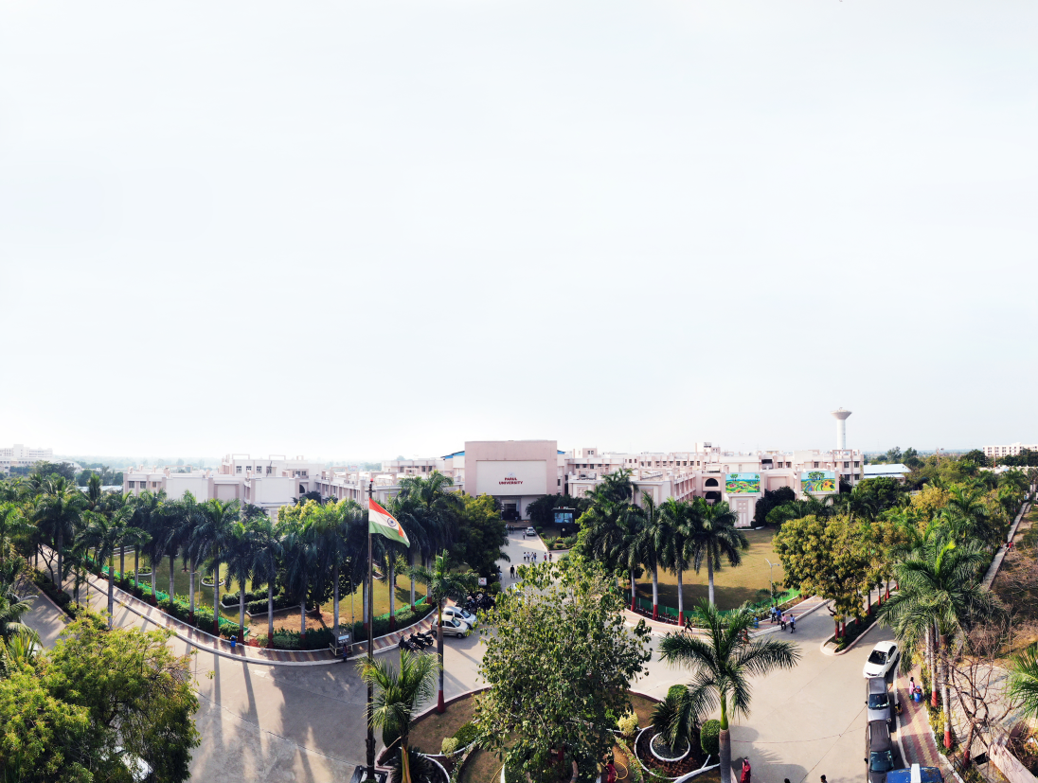


Object Oriented Concepts with UML (203105207)
Prof. Shaleen Shukla, Assistant Professor
Information Technology

Slide 2
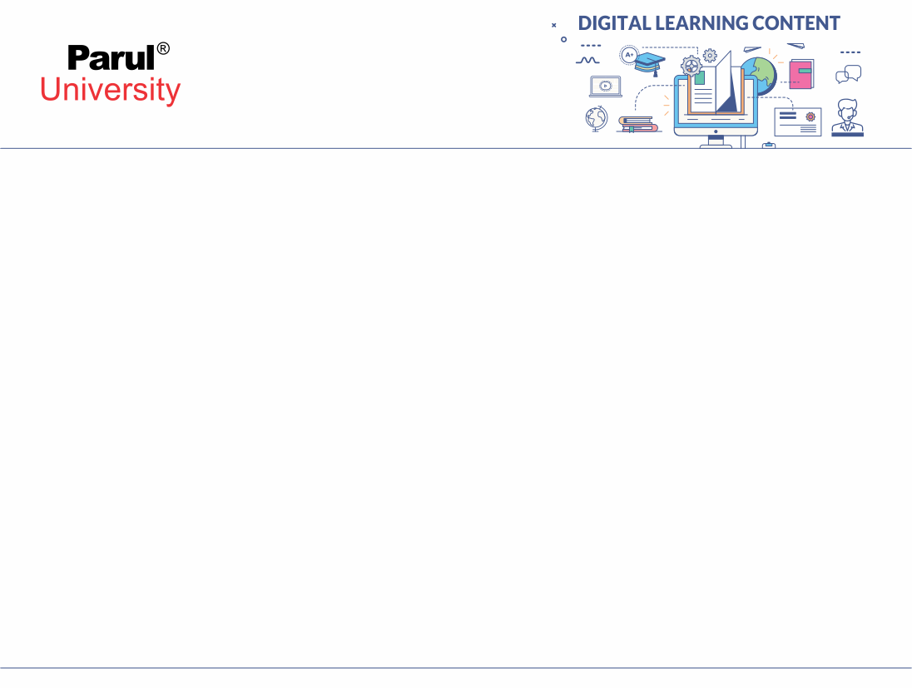

CHAPTER-4
Analysis and Design

Slide 3
SOFTWARE DEVELOPMENT STAGES

Slide 4
Software Development Stages
System conception
Analysis
System design
Class design
Implementation
Testing
Training
Deployment
Maintenance

Slide 5
Software Development Life Cycle
SDLC is a process used by the software industry to design, develop and test high quality software's.
Two Types
Waterfall Development
Iterative Development
Model: Model is an abstraction of something for the purpose of understanding it, before building.
Abstract: Thought, idea

Slide 6
SOFTWARE DEVELOPMENT LIFE CYCLE

Slide 7
Waterfall Development
The developers perform the software development stages in a rigid linear sequence
No backtracking
First capture requirement
Then perform a system design
Then prepare a class design
Then implementation
Testing
Deployment..

Slide 8
Waterfall Development
Each stage is completed in its entirety before the next stage is begun
It is suitable for well-understood applications with predictable outputs from analysis and design
Too many organizations attempt to follow a waterfall when requirements are fluid
This leads to familiar situation where developers complain about changing requirement, the business complains about inflexible software development

Slide 9
Waterfall Development
It is not a useful system until completion
This makes it difficult to assess progress and correct a project that has gone awry
Examples of Waterfall Model
In the olden days, Waterfall model was used to develop enterprise applications like Customer Relationship Management (CRM) systems, Human Resource Management Systems (HRMS), Supply Chain Management Systems, Inventory Management Systems, Point of Sales (POS) systems for Retail chains etc.

Slide 10
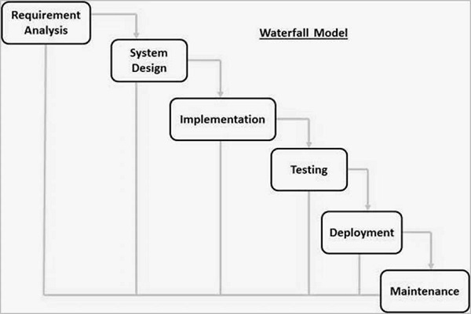
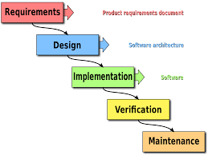
Waterfall Development
Figure: 4.1 Waterfall Development
Image source : en.wikipedia.org
Figure: 4.2 Waterfall Development
Image source : tutorialspoint.om

Slide 11
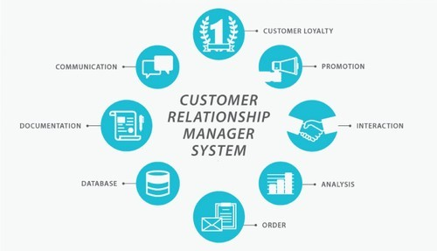
Customer Relationship Management System
Customer relationship management (CRM) is an approach to managing a company's interaction with current and potential customers. It uses data analysis about customers' history with a company to improve business relationships with customers, specifically focusing on customer retention and ultimately driving sales growth.
Figure: 4.3 Customer Relationship Management System
Image source : indiamart.com

Slide 12
Iterative Development
It is more flexible
First you develop the nucleus system
Analyzing
Designing
Implementing
Delivering working code
Then you grow scope of the system, adding properties and behavior to existing objects
There are multiple iterations as the system evolves to the final deliverable
Each iteration includes full complement of stages
Unlike strict sequence of the waterfall model, iterative development can interleave the different stages
need not construct the entire system in lock step
Some parts may be completed early

Slide 13
Iterative Development
Other crucial parts are completed later
Each iteration ultimately yields an executable system that can be integrated and tested
If any problem, you can move backward to earlier stage for rework
It gracefully responds to change and minimizes risks of failure
Examples of Iterative Model
User Interfaces. A requirement of a film company needs a custom system for equipment tracking, costumes, and props. ...
Graphic Design. The advertising agencies creative department has 2 weeks to produce an ad print to a customer. ...
Architecture. ...
Marketing. ...
Urban Design.

Slide 14
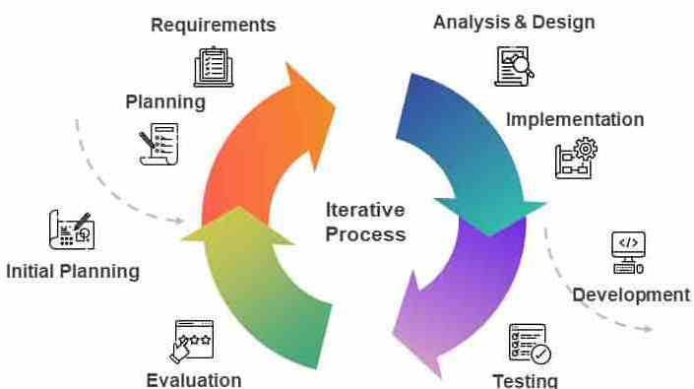
Iterative Process/Development Model
Figure: 4.4 Iterative /Development Model
Image source : slidebazzar.com

Slide 15
DOMAIN ANALYSIS

Slide 16
Domain Analysis
INTRODUCTION:
Domain analysis is concerned with devising a precise, concise, understandable and correct model of the real world
During analysis, we build models and begin to understand the requirements deeply
To build a domain model,
Interview business experts
Examine requirements statements
Restate them rigorously
The successful analysis model states
What must be done, without restricting how it is done
Avoids implementation decisions

Slide 17
Domain Analysis
OVERVIEW OF ANALYSIS:
Analysis begins with a problem statement generated during system conception
The statement may be incomplete or informal
Analysis makes it more precise and exposes ambiguities and inconsistencies
Statements in natural language are often ambiguous, incomplete and inconsistent
The analysis model is concise representation of the problem that permits answering questions and building a solution

Slide 18
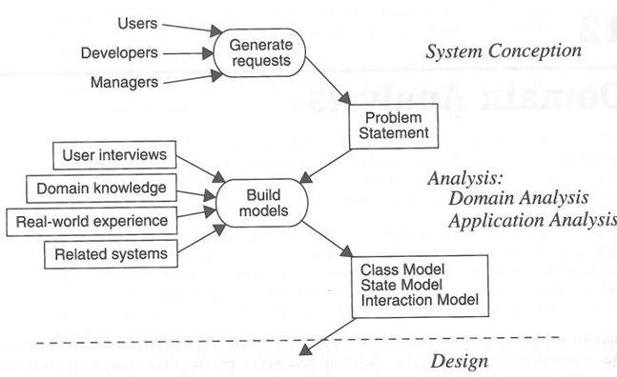
Domain Analysis
OVERVIEW OF ANALYSIS:
Figure: 4.5 Overview of Analysis
Image source : Book: OOMD with UML by Blaha/Rumbaugh

Slide 19
Domain Analysis
OVERVIEW OF ANALYSIS:
Subsequent design steps refer to analysis model rather than the original vague problem statement
The analysis model addresses the three aspects of objects
Static structure of objects
Interactions among objects
Lifecycle histories of objects

Slide 20
Domain Class Model
The domain model shows the static structure of the real world system and organizes it into workable pieces
It describes real world classes and its relationships to each other
Make sure you consider all information that is available and do not rely on a single source

Slide 21
Domain Class Model
Steps to be performed to construct a domain class model
Find classes
Prepare a data dictionary
Find associations
Find attributes of objects and links
Organize and simplify classes using inheritance
Verify that access paths exists for likely queries
Iterate and refine the model
Reconsider the level of abstraction
Group classes into packages

Slide 22
Domain Class Model
FIND CLASSES
Find relevant classes for objects from the application domain
Object includes physical entities as well as concepts
Avoid computer implementation constructs such as linked lists and subroutines
Classes often correspond to nouns
The idea is to capture concepts

Slide 23
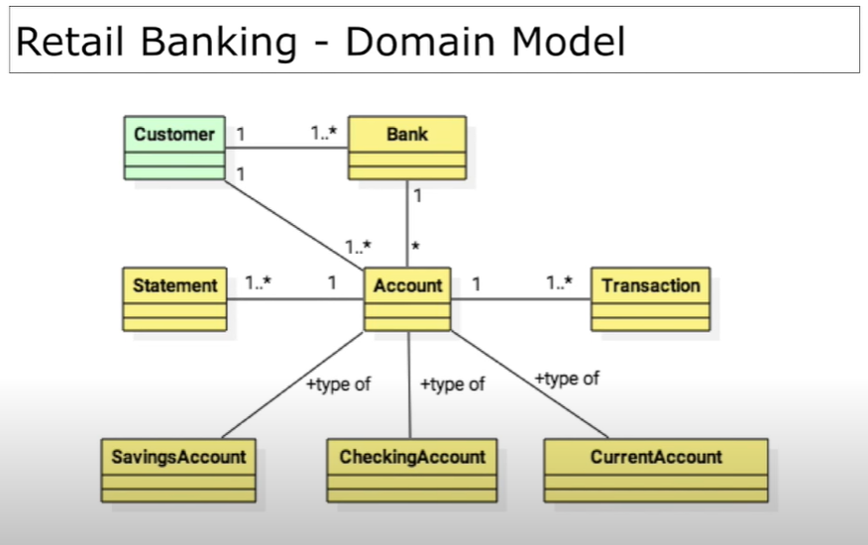
Domain Class Model

Slide 24
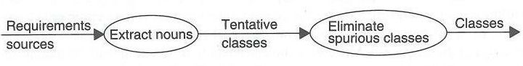
Domain Class Model
FIND CLASSES
For e.g. “a reservation system to sell tickets to performances at various theaters”
Tentative classes: Reservation, System, Tickets, Performance, and Theatre.
Don’t worry much about inheritance or high-level classes
Figure: 4.6 Finding Classes
Image source : Book: OOMD with UML by Blaha/Rumbaugh

Slide 25
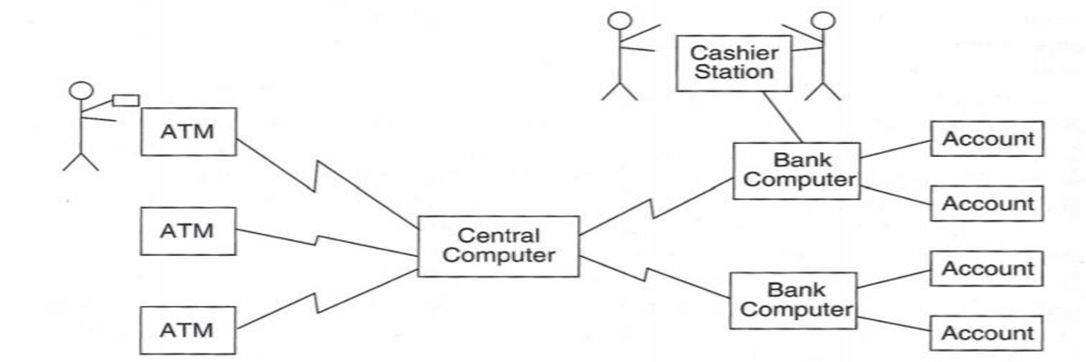
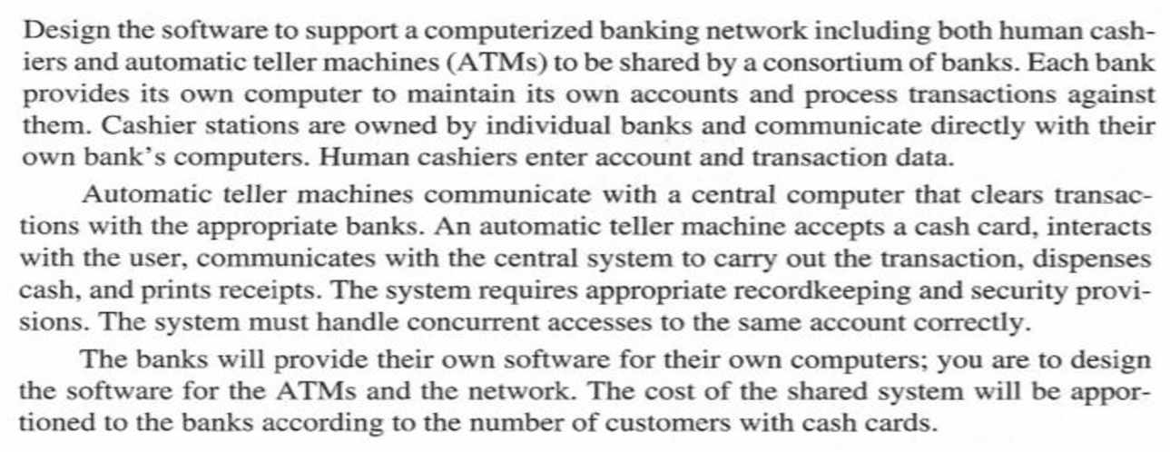
ATM Case Study
Figure: 4.7 ATM Network . Case Study Throughout the Unit
Image source : Book: OOMD with UML by Blaha/Rumbaugh

Slide 26
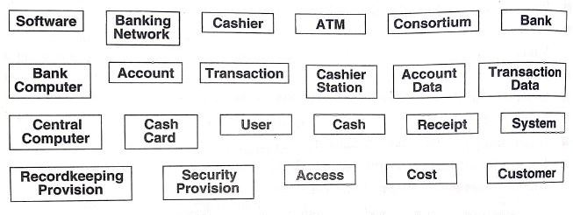
ATM Example: Tentative Classes
Figure: 4.8 ATM Classes Extracted from problem statement nouns
Image source : Book: OOMD with UML by Blaha/Rumbaugh

Slide 27
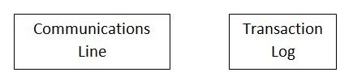
ATM Example: Additional Classes
Figure: 4.9 ATM Classes Identified from knowledge of problem domain
Image source : Book: OOMD with UML by Blaha/Rumbaugh

Slide 28
Domain Class Model
KEEPING THE RIGHT CLASSES
Discard unnecessary and incorrect classes according to following criteria
Redundant classes
two classes express the same concept, keep the most descriptive name
Irrelevant class
Class having nothing to do with the problem, eliminate it
Vague
A class should be specific
Some tentative classes may have ill-defined boundaries or be too broad in scope

Slide 29
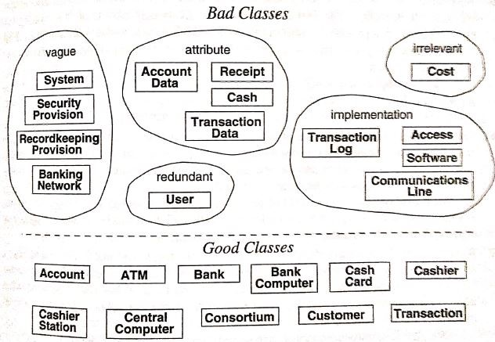
Domain Class Model
Figure: 4.10 Eliminating unnecessary classes from ATM problem
Image source : Book: OOMD with UML by Blaha/Rumbaugh

Slide 30
Domain Class Model
Attributes
Names that primarily describe individual objects should be restated as attributes
Ex. Name, birth date, etc.
If the independent existence of a property is important, make it a class
Operations
If name describes an operation that is applied to objects, and not manipulated in its own right, then it is not a class
An operations has features of its own should be modeled as a class
Roles
The name of the class should reflect its intrinsic nature, Not a role that it plays in an association
Ex. Owner would be a poor name for a class in a car manufacturer’s database, Person would be suitable

Slide 31
Domain Class Model
Implementation constructs
Eliminate constructs from the analysis model that are extraneous to the real world
You may need them during design
Ex. CPU, subroutine, algorithms, etc,.
Derived classes
Omit the classes that can be derived from other classes
If a derived class is important, you can include it
Mark derived classes with a preceding slash (‘/’) in the class name

Slide 32
Domain Class Model
PREPARING A DATA DICTIONARY
Isolated words have too many interpretations
So prepare a data dictionary for all modeling elements
Write a paragraph precisely describing each class
Describe the scope of the class within the current problem
Data dictionary also describes associations, attributes, operations and enumerations

Slide 33
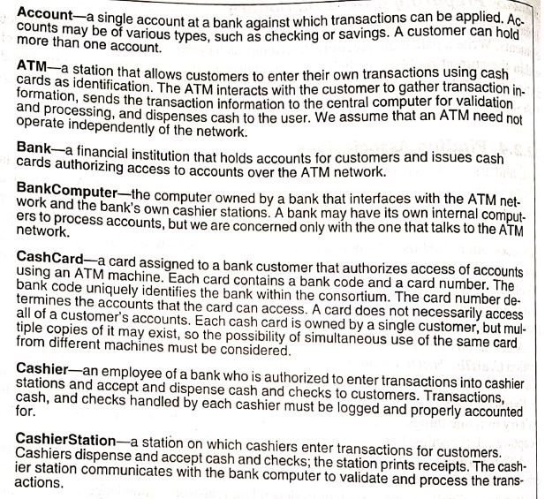
Domain Class Model
Figure: 4.11.1 Data Dictionary for ATM Classes
Image source : Book: OOMD with UML by Blaha/Rumbaugh

Slide 34
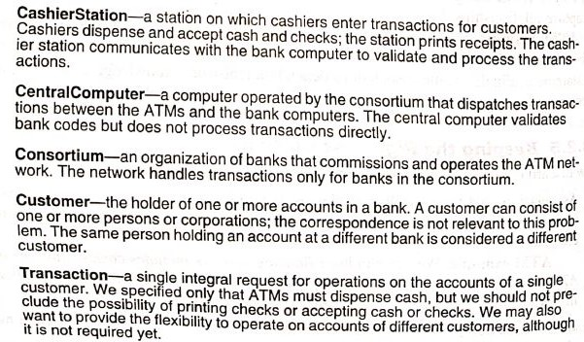
Domain Class Model
Figure: 4.11.2 Data Dictionary for ATM Classes
Image source : Book: OOMD with UML by Blaha/Rumbaugh

Slide 35
Domain Class Model
FINDING ASSOCIATIONS
A structural relationship between two or more classes is an association.
A reference from one class to another is an association.
• Idea here is to capture relationshipsThey include
Physical location (Next To, PartOf, ContainedIn)
Directed actions (Drives)
Communication (TalksTo)
Ownership (Has, PartOf)
Etc…

Slide 36
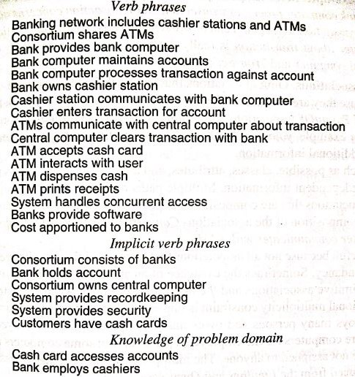
Domain Class Model
Figure: 4.12 Association from ATM problem staement
Image source : Book: OOMD with UML by Blaha/Rumbaugh

Slide 37
Domain Class Model
KEEPING THE RIGHT ASSOCIATIONS
Associations between eliminated classes
Eliminate associations between eliminated classes
Irrelevant or implementation associations
Eliminate any associations that are outside the problem domain or deal with implementations constructs
Actions
An association should describe a structural property of the application domain, not a transient event
Ex. ATM accepts cash cards describes part of the interaction cycle between an ATM and a customer
Not a permanent relationship between ATM and cash card

Slide 38
Domain Class Model
Ternary associations
Decompose ternary associations into binary associations
Derived associations
Omit associations that can be defined in terms of other associations, they are redundant
Ex. GrandparentOf can be defined in terms of ParentOf associations
Omit the associations defined by conditions on attributes
Ex. YoungerThan

Slide 39
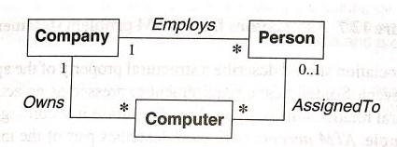
Domain Class Model
Figure: 4.13 No redundant associations
Image source : Book: OOMD with UML by Blaha/Rumbaugh

Slide 40
Domain Class Model
Misnamed associations
Names are important to understanding
Should be chosen with great care
Association end names
Add association end names where appropriate
Qualified associations
Usually a name identifies an object within some context
Most names are not globally unique
The context combines with name to uniquely identify an object
A qualifier distinguishes object on “many” side of associations

Slide 41
Domain Class Model
Multiplicity
Don’t put too much effort into getting it right
It often changes during analysis
Missing associations
Add any missing associations that are discovered
Aggregation
For some applications, aggregation is relatively minor
It can be unclear whether to use aggregation or ordinary association
So don’t spend much time trying to distinguish between them

Slide 42
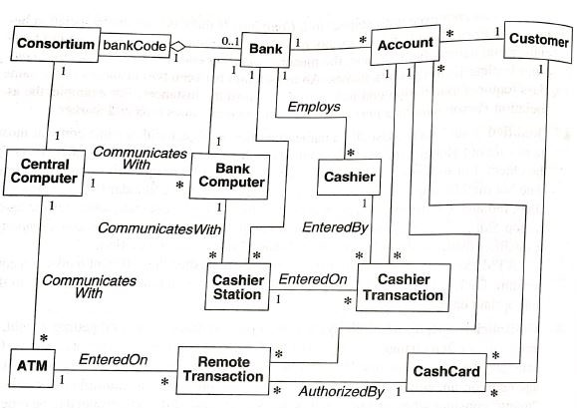
Domain Class Model
Figure: 4.14 Initial Class Diagram for ATM System
ATM Example: We decide that a bank is a consortium and indicate the relationship with aggregation
ATM Example: Figure 4.14 shows a class diagram with the remaining associations. Only significant association names are included
Image source : Book: OOMD with UML by Blaha/Rumbaugh

Slide 43
Domain Class Model
FINDING ATTRIBUTES
They are data properties of individual objects
attribute values should not be objects
Use an association to show any relationship between two objects
Attributes are less likely to be defined in the problem statement
Draw your knowledge of the application domain and the real world to find them
Only consider attributes directly relevant to the system

Slide 44
Domain Class Model
KEEPING RIGHT ATTRIBUTES
Eliminate unnecessary and incorrect attributes with the following criteria
Objects
If the independent existence of an element is important, it is an object
The distinction often depends on the application
Ex. In mailing list city might be considered an attribute
While in census City would be a class with many attributes

Slide 45
Domain Class Model
Qualifier
If the value of an attribute depends in a particular context, then consider restating the attribute as a qualifier
Name
A name is an attribute when its use does not depend on context
Especially when it need not be unique within some set

Slide 46
Domain Class Model
Identifiers
Do not include an attribute whose only purpose is to identify an object
Object identifiers are implicit in class model
Attributes on association
If a value requires the presence of a link, the property is an attribute of the association
Not of a related class

Slide 47
Domain Class Model
Internal values
If an attribute describes the internal state of an object that is invisible outside the object, then eliminate it from the analysis
Fine detail
Omit minor attributes that are unlikely to affect most operations
Discordant attributes
Unrelated attribute to all other attributes may indicate a class that should be split into two distinct classes.
Boolean attributes
Reconsider all boolean attributes.

Slide 48
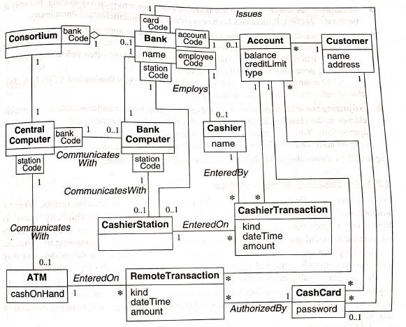
Domain Class Model
Figure: 4.15 ATM class model with attributes
Image source : Book: OOMD with UML by Blaha/Rumbaugh

Slide 49
Domain Class Model
REFINING WITH INHERITANCE
The next step to organize classes by using inheritance to share common structure
It can be added in two directions:
By generalizing common aspects of existing classes into a super class(bottom up)
By specializing existing classes into multiple subclasses (top down)

Slide 50
Domain Class Model
Bottom-up
Discover inheritance from the bottom up by searching for classes with similar attributes, associations, and operations
For each generalization, define a superclass to share common features
Top-down
Apparent from the application domain
Look for the noun phrases composed of various adjectives on the class name
Ex. Fluorescent lamp, incandescent lamp, fixed men, pop-up menu

Slide 51
Domain Class Model
Multiple inheritance
You can use multiple inheritance to increase sharing, but only if necessary
Similar associations
When the same association name appears more than once with substantially the same meaning, try to generalize the associated class
Adjusting the inheritance level
Must assign attributes and associations to specific classes in the class hierarchy
Assign each one to the most general class for which it is appropriate

Slide 52
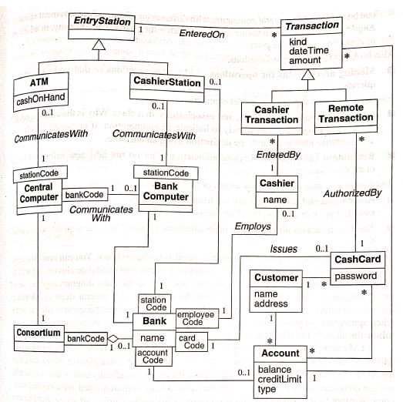
Domain Class Model
Figure: 4.16 ATM class model with attributes and inheritance
Image source : Book: OOMD with UML by Blaha/Rumbaugh

Slide 53
Domain Class Model
TESTING ACCESS PATHS
Trace the access path through the class model to see if they yield sensible result
For example,
Where a unique value is expected, is there a path yielding a unique value???
Think of the questions you might like to ask
Are there useful questions that cannot be answered?
They indicate missing information

Slide 54
Domain Class Model
ITERATING A CLASS MODEL
A class model is rarely correct after a single pass
The entire software development process is one of the continual iteration
Different parts of a model are often at different stages of completion
If you find any deficiency, go back to an earlier stage if necessary to correct it
Some refinements can come only after completing the state and the interaction models

Slide 55
Domain Class Model
Several signs of missing classes
Asymmetries in associations and generalizations
Difficulty in generalizing clearly
Duplicate associations with the same name and purpose
Missing access path for operations
Lack of attributes, operations, and associations on a class
Redundant information, etc…

Slide 56
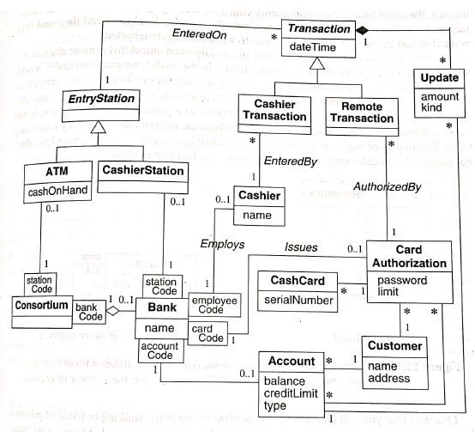
Domain Class Model
Figure: 4.17 ATM class model after further revision
Image source : Book: OOMD with UML by Blaha/Rumbaugh

Slide 57
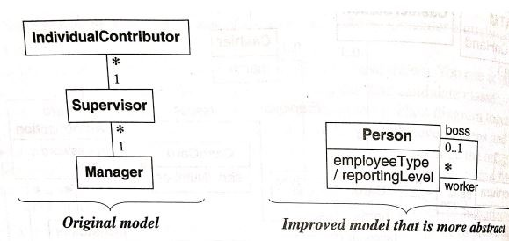
Domain Class Model
SHIFTING THE LEVEL OF ABSTRACTION
Previous analysis we done is not always suffice
Sometimes you must raise level of abstraction to solve a problem
For example,
Figure: 4.18 Shifting the level of abstraction
Image source : Book: OOMD with UML by Blaha/Rumbaugh

Slide 58
Domain Class Model
GROUPING CLASSES IN PACKAGES
A package is a group of elements with a common theme
Elements may be classes, associations, generalizations and lesser packages
Packages organize a model for convenience in drawing, printing and viewing
Classes in the same package are more closely related than classes in different packages

Slide 59
Domain State Model
Some domain objects pass through qualitatively distinct states during their lifetime
There may be different constraints on attribute values, different associations or multiplicities in the various states
Different operations that may be invoked
Different behavior of the operations

Slide 60
Domain State Model
The state diagram describes the various states the object can assume
The properties and constraints of the objects in various states
And events that take an object from one state to another state
Most domain classes do not require state diagrams
For minority of classes that do exhibit distinct states, a state model can help in understanding their behavior

Slide 61
Domain State Model
Steps performed in constructing a domain state model
Identify domain classes with states
Find states
Find events
Build state diagrams
Evaluate state diagrams

Slide 62
Domain State Model
IDENTIFYING CLASSES WITH STATES
Examine list of domain classes which have distinct life cycle
Look for the classes that can be characterized by a progressive history
Identify the significant states in the life cycle of the object

Slide 63
Domain State Model
FINDING STATES
List the states for each class
Characterize the objects in each class
Give each state a meaningful name
It is necessary to determine all the states before examining events
By looking at events and considering transitions among states, missing states will become clear

Slide 64
Domain State Model
FINDING EVENTS
Find events that cause transitions among states
Think about the stimuli that cause a state to change
In many cases, you can regard an event as completing a do-activity

Slide 65
Domain State Model
BUILDING STATE DIAGRAMS
Note the states to which each event applies
Add transitions to show the change in states caused by occurrence of an event
If an event terminates a state, it will usually have a single transition from the state to another state
If an event initiates a target state, then consider where it occur,and add transitions from those states to the target states

Slide 66
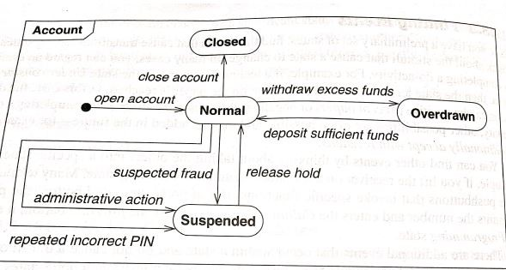
Domain State Model
Figure 4.19: Domain state model for accounts class
Image source : Book: OOMD with UML by Blaha/Rumbaugh

Slide 67
Domain State Model
EVALUATING STATE DIAGRAMS
Examine each state model
Are all the states connected???
Pay particular attention to paths through it
If it represents a progressive class, is there a path from the initial state to the final state??
Are the expected variations present??
Etc…

Slide 68
Domain Interaction Model
The interaction model is seldom important for domain analysis
During domain analysis the emphasis is on key concepts and deep structural relationships
Not the user’s view of them
The interaction model is an important aspect of application modeling

Slide 69
Domain Interaction Model
ITERATING THE ANALYSIS
Most analysis models require more than one pass to complete
Problem statements often contain circularities
Most applications cannot be approached in completely linear way
To understand a problem with all implications, you must attack the analysis iteratively

Slide 70
Domain Interaction Model
STEPS:
Refining the analysis model
Restating the requirements
Analysis and design

Slide 71
APPLICATION ANALYSIS

Slide 72
Application Interaction Model
After completing the domain model, we shift out attention to the details of an application and consider interaction

Slide 73
Application Interaction Model
Steps for constructing application interaction model
Determine the system boundary
Find actors
Find use cases
Find initial and final events
Prepare normal scenarios
Add variation and exception scenarios
Find external events
Prepare activity diagrams for complex use cases
Organize actors and use cases
Check against the domain class model

Slide 74
Application Interaction Model
DETERMINING THE SYSTEM BOUNDARY
You must know the scope of the application in order to specify functionality
You must decide what the system includes and what it omits
During analysis, you determine the purpose of the system and the view that it presents to its actors

Slide 75
Application Interaction Model
FINDING ACTORS
After defining the system boundary, you must identify the external objects that directly interact with the system
Actors are not under control of the application
Each actor represents idealized user that exercises some subset of the system functionalities

Slide 76
Application Interaction Model
FINDING USE CASES
For each actor, list the fundamentally different ways in which the actor uses the system
Each of these ways is a use case
They partition the functionality of a system into small number of discrete units

Slide 77
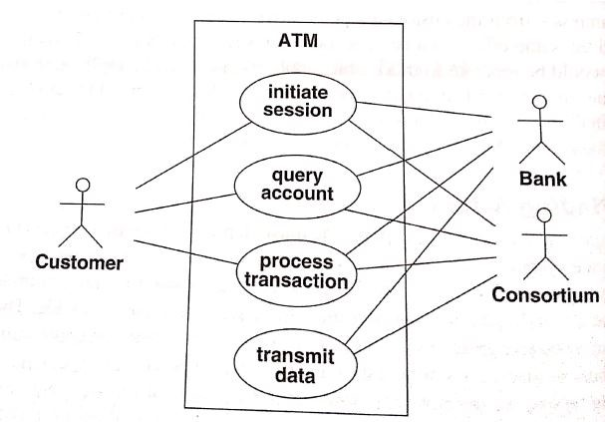
Application Interaction Model
Initiate Session: The ATM establishes the identity of the user and makes available a list of accounts and actions
Query Account: The system provides general data for an account, such as current balance, date of last transaction, and date of mailing for last statement
Process Transaction: The ATM system performs an action that affects ad account’s balance , such as deposit, withdraw, and transfer. The ATM ensures that all completed transactions are ultimately written to the bank’s database
Transmit Data: The ATM uses the consortium’s facilities to communicate with the appropriate bank computers.
Figure 4.20 Use case diagram for the ATM. Bullets summarize themes.
Image source : Book: OOMD with UML by Blaha/Rumbaugh

Slide 78
Application Interaction Model
FINDING INITIAL AND FINAL STATES
Use cases do not show the behavior clearly
To understand it, you must understand the execution sequence
You can start by finding the events that initiate each use cases that cover each use case
Determine which actor will initiate the use case
Define the event that it sends to the system
You should also determine the final event or events and how to include in each use case

Slide 79
Application Interaction Model
ATM Example. Here are initial and final events for each use case
Initiate Session:
Initial Event: Customer insertion of a card.
Final Event: system keeps the card or returns the card
Query Account:
Initial Event: customer’s request for account data
Final Event: system’s delivery of final data
Process Transaction:
Initial Event: customer’s initiation of a transaction
Final Event: committing or aborting the transaction
Transmit Data:
Initial Event: customers request for account data or recovery from network, power or another kind of failure
Final Event: successful transmission of data.

Slide 80
Application Interaction Model
PREPARING NORMAL SCENARIOS
A scenario is a sequence of events among a set of interacting objects
Think in terms of sample interactions, rather than trying to write down general case directly

Slide 81
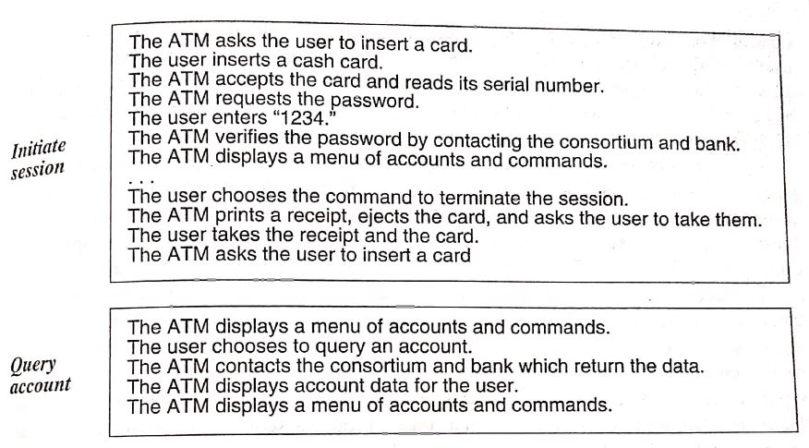
Application Interaction Model
Figure 4.21.1: Normal ATM Scenarios.
*Prepare one or more scenarios for each use case.
Image source : Book: OOMD with UML by Blaha/Rumbaugh

Slide 82
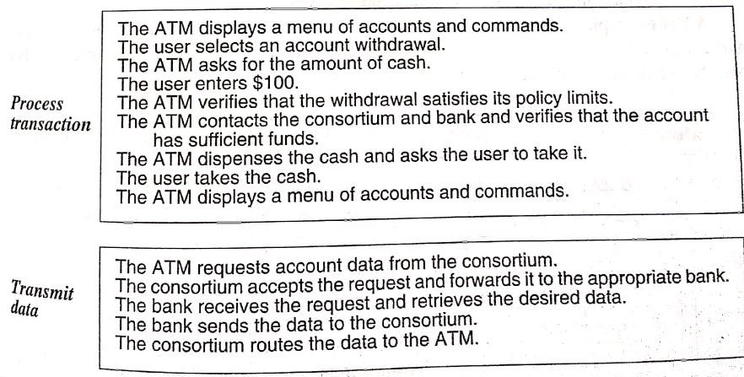
Application Interaction Model
Figure 4.21.2: Normal ATM Scenarios.
*Prepare one or more scenarios for each use case.
Image source : Book: OOMD with UML by Blaha/Rumbaugh

Slide 83
Application Interaction Model
ADDING VARIATION AND EXECPTION SCENERIO
After preparing the typical scenarios, consider special cases
Such as omitted input, maximum and minimum values and repeated values
Then consider error cases, including invalid values and failure to respond
ATM Example:
ATM Can’t read the card
Card has expired
ATM times out
Amount is invalid
Machine is out of cash
Communication lines are down
Transaction is rejected because of suspicious pattern of card usage

Slide 84
Application Interaction Model
FINDING EXTERNAL EVENTS
Examine the scenarios to find all external events
Include all inputs, decisions, interrupts and interactions to or from users or external devices
An event can trigger effects for a target object
Internal computation steps are not events, except for computations that interact with the external world
A transmittal to an object is an event
Group together under a same name events that have the same effect on flow of control

Slide 85
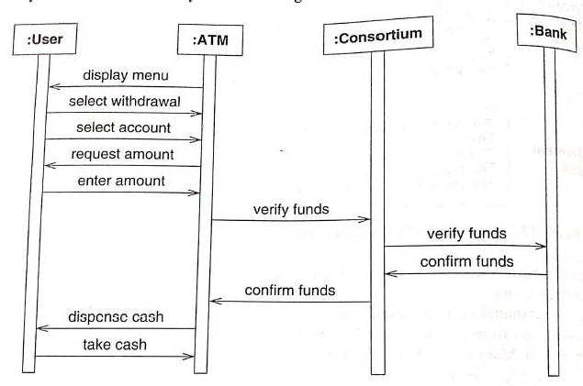
Application Interaction Model
PREPARING SEQUENCE DIAGRAM FOR EACH SCENARIOS
Figure: 4.22 Sequence diagram for the process transaction scenario.
* A sequence diagram clearly shows the sender and receiver of each event
Image source : Book: OOMD with UML by Blaha/Rumbaugh

Slide 86
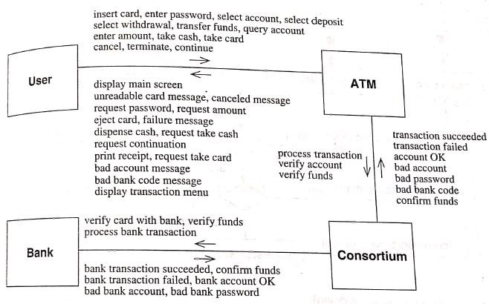
Application Interaction Model
Figure: 4.23 Events for the ATM case study.
* Tally the events in the scenario and note the classes that send and receive each event
Image source : Book: OOMD with UML by Blaha/Rumbaugh

Slide 87
Application Interaction Model
PREPARING ACTIVITY DIAGRAMS FOR COMPLEX USE CASES
Sequence diagrams capture dialog and interplay between the actors
They do not clearly shows the decisions and alternatives
Activity diagrams let you consolidate all this behavior by documenting forks and merges in the control flow

Slide 88
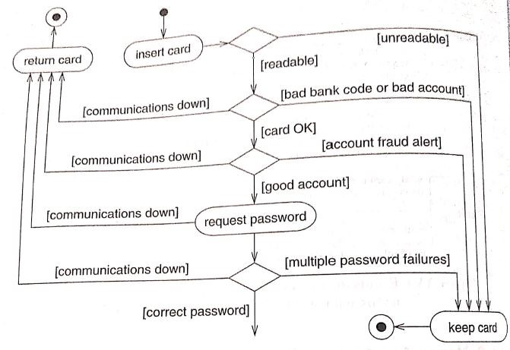
Application Interaction Model
Figure 4.24 Activity diagram for card verification.
* You can use activity diagrams to document business logic, but do not use them as an excuse to begin premature implementation
Image source : Book: OOMD with UML by Blaha/Rumbaugh

Slide 89
Application Interaction Model
ORGANIZING ACTORS AND USE CASES
The next step is to organize use cases with relationships (include, extend and generalization)
This is especially helpful for large and complex systems

Slide 90
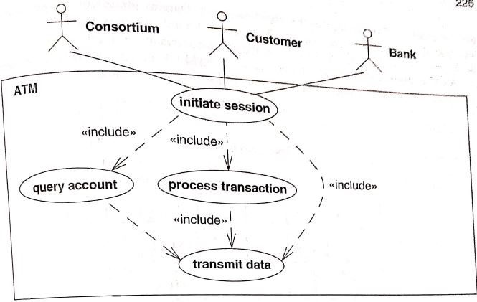
Application Interaction Model
Figure: 4.25 Organizing use cases.
* Once the basic use cases are identified, you can organize them with relationships.
Image source : Book: OOMD with UML by Blaha/Rumbaugh

Slide 91
Application Interaction Model
CHECKING AGAINST THE DOMAIN CLASS MODEL
The application and domain models should be mostly consistent
The actors, use cases and scenarios are all based on classes and concepts from the domain model
Cross check the application and domain models to ensure that there are no inconsistencies
Examine the scenarios and make sure that domain model has all necessary data

Slide 92
Application Class Model
Application classes define application itself, rather than real world objects that the application acts on
Most applications classes are computer-oriented and define the way that users perceive the application

Slide 93
Application Class Model
STEPS TO CONSTRUCT APPLICATION CLASS MODEL
Specify user interfaces
Define boundary classes
Determine controllers
Check against the interaction model

Slide 94
Application Class Model
SPECIFYING USER INTERFACES
Most interactions can be separated into two ways
Application logic
User interface
A user interface is an object or group of objects that provides the user of a system with coherent way to access its domain objects, commands and application options
During analysis the emphasis is on the information flow and control rather than presentation

Slide 95
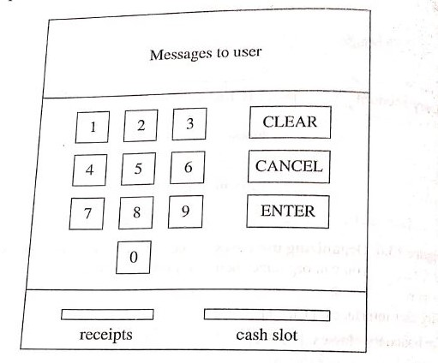
Application Class Model
Figure: 4.26 Format of an ATM interface.
* Sometimes a sample interface can help you visualize the operation of an application.
Image source : Book: OOMD with UML by Blaha/Rumbaugh

Slide 96
Application Class Model
DEFINING BOUNDARY CLASSES
A system must be able to operate with and accept information from external sources
But it should have its internal structure dictated by them
A boundary class is a class that provides a staging area for communications between a system and an external source
A boundary class understands the format of one or more external sources and converts information for transmission to and from the internal system

Slide 97
Application Class Model
DETERMINING CONTROLLERS
A controller is an active object that manages control within an application
It receives signals from the outside world or from objects within the system, reacts to them, invokes operations and send signals to the outside world
Most of the work in designing a controller is in modeling its state diagram
In application class model, you should capture the existence of the controller in a system, the control information that each one maintains, the associations from the controllers to the other objects

Slide 98
Application Class Model
CHECKING AGAINST THE INTERACTION MODEL
As you build the application class model, go over the use cases and think about how they would work

Slide 99
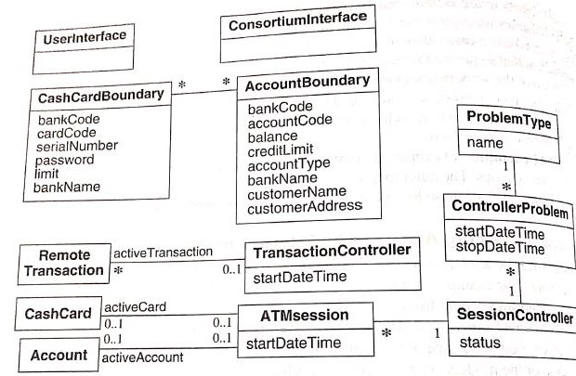
Application Class Model
Figure: 4.27 ATM application class model.
* Application classes augment the domain classes and are necessary for development
Image source : Book: OOMD with UML by Blaha/Rumbaugh

Slide 100
Application State Model
Focuses on application classes and arguments the domain state model
Application classes are more likely to have important temporal behavior than domain classes
Steps for constructing application state model:
Determine application classes with states
Find events

Slide 101
Application State Model
Build state diagrams
Check against other state diagrams
Check against the class model
Check against the interaction model

Slide 102
Application State Model
DETERMINING APPLICATION CLASSES WITH STATES
The application class model adds computer-oriented classes that are important prominent to users
Also important to the operation of an application
Consider each class and determine which class has multiple states
User interface classes and controller classes are good candidates for state models

Slide 103
Application State Model
FIDING EVENTS
Study the scenario, prepared previously, and extract events
They will highlight the major events
With domain state model, first we find states and then we find events
Because the domain model focuses on data
Significant grouping of data form states that are subject to events

Slide 104
Application State Model
With the application state model, first we find events and then we determine states
Because the focus is on behavior
Use cases are elaborated with scenarios that reveal events

Slide 105
Application State Model
BUILDING STATE DIAGRAMS
Build state diagram for each application class with temporal behavior

Slide 106
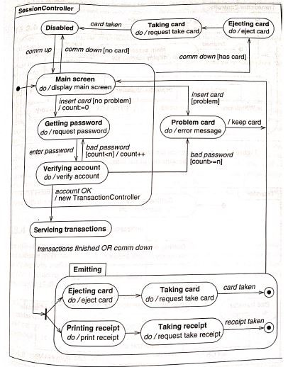
Application State Model
Figure: 4.28 State diagram for SessionController.
* Build a state diagram for each application class with temporal behaviour
Image source : Book: OOMD with UML by Blaha/Rumbaugh

Slide 107
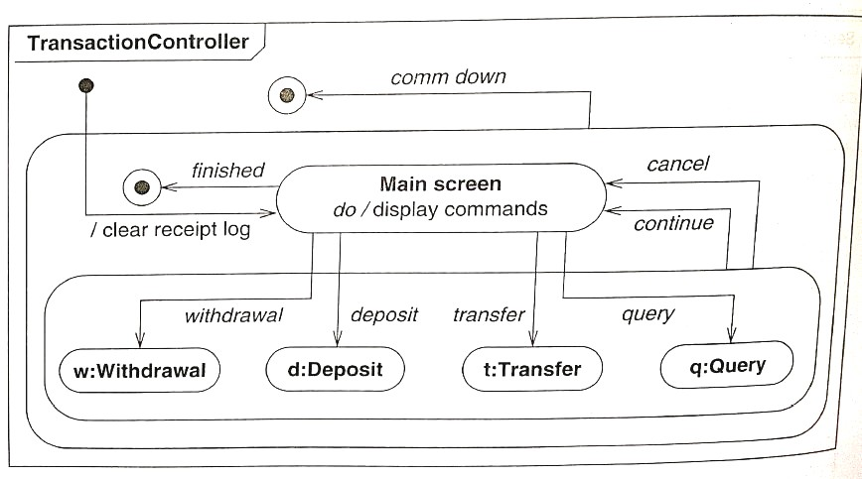
Application State Model
Figure: 4.29 State diagram for TransactionController.
* Obtain information from the scenario of the interaction model.
Image source : Book: OOMD with UML by Blaha/Rumbaugh

Slide 108
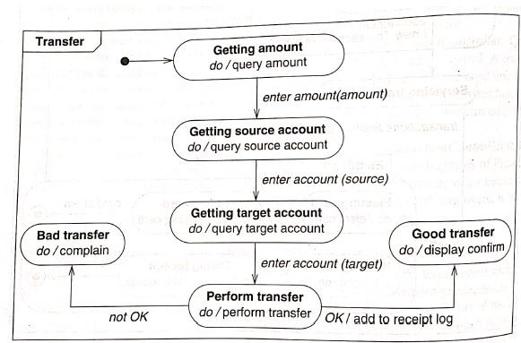
Application State Model
Figure: 4.30 State diagram for Transfer.
* This diagram elaborates the Transfer state in Figure 4.29
Image source : Book: OOMD with UML by Blaha/Rumbaugh

Slide 109
Application State Model
CHECKING AGAINST OTHER STATE DIAGRAMS
Check the state diagrams for each class for completeness and consistency
ATM Example:
The SessionController initiates the TransactionController, and the termination of the TransactionController causes the Session Controller to resume

Slide 110
Application State Model
CHECKING AGAINST CLASS MODEL
Make sure that state diagrams are consistent with the domain and application class model

Slide 111
Application State Model
CHECKING AGAINST INTERACTION MODEL
When state model is ready, go back and check it against the scenarios of the interaction model
Verify that the state diagram gives the correct behavior

Slide 112
Application State Model
ADDING OPERATIONS
Operations from the class model
Operation from use cases
Shopping-list operations
Sometimes real-world behavior of classes suggest operations
These operations are not dependent on a particular application but are meaningful in their own weight
Ex. Account.close()
Bank.createCashcardAuth(customer)

Slide 113
Application State Model
Simplifying operations
Examine the class model for similar operations and variations in form on a single operation
Use inheritance where possible to reduce the number of operations
Locate each operation at correct level

Slide 114
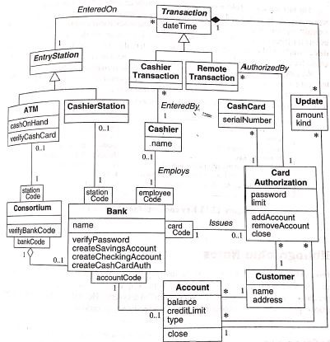
Application State Model
Figure: 4.31 ATM domain class model with some operations
Image source : Book: OOMD with UML by Blaha/Rumbaugh

Slide 115
References
Object oriented Modeling and Design with UML (TextBook)
By Michael R Blaha and James R Rambaugh.
http://tryqa.com/what-is-waterfall-model-advantages-disadvantages-and-when-to-use-it/
https://en.wikipedia.org/wiki/Waterfall_model
https://www.tutorialspoint.com/sdlc/sdlc_waterfall_model.htm
https://www.indiamart.com/
https://slidebazaar.com/

Slide 116


www.paruluniversity.ac.in

